Slide 1
Home Theatre PC
Ashmitha Kanagiah & Bridgette Nania Centro

Slide 2
PC CHARACTERISTICS:
PC Build: Home Theater PC
Budget: Low ( < 2000 $)
Features and utilization:
Budget friendly build under 1000$
4K streaming at 60hz
Comfortability for a home theatre
Small form factor
Low power consumption

Slide 3
PC COMPONENTS
+
PARTS CHOSEN

Slide 4
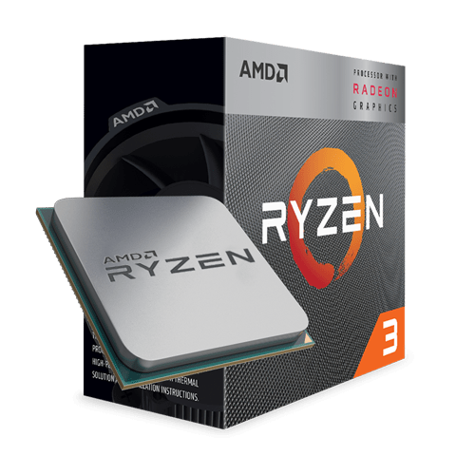
CPU
AMD Ryzen 3 3200G 3.6 GHz Quad-Core Processor
4 processing cores, bundled with the Quiet AMD Wraith Stealth cooler
4.0 GHz Max Boost, unlocked for overclocking, 6 MB Cache, ddr-2933 support
Radeon Vega 8 graphics
High-definition performance in the world's most popular games.
For the advanced socket AM4 platform.
System memory type is DDR4
Maximum temperature - 95 degree celsius
Vendor: ShopRBC
Price: 159.95$ CAD

Slide 5
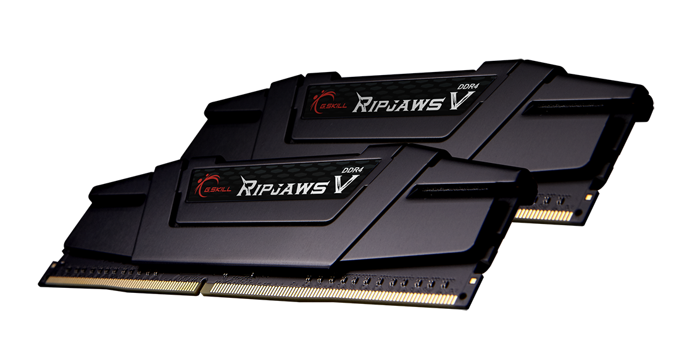
RAM
G.Skill Ripjaws V Series 8 GB (2 x 4 GB) DDR4-3200 CL16 Memory
The memory sticks offer a maximum compatibility and cutting-edge performance with the speed of 3.200 MHz DDR4 memory with CAS latency of 16-18-18-35
Vendor: MemoryExpress
Price: 75$ CAD

Slide 6
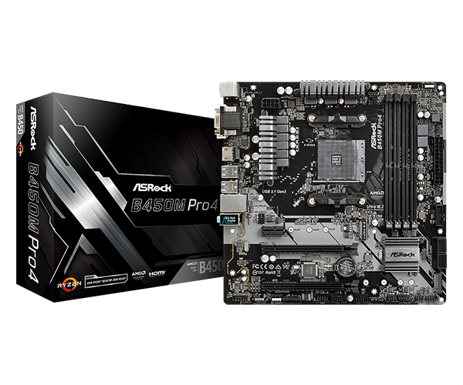
MOTHERBOARD
ASRock B450M PRO4 Micro ATX AM4 Motherboard
All the essentials.
Supports AMD AM4 Socket Ryzen 2000, 3000 and 5000 Series Desktop Processors
Graphics Output: HDMI, DVI-D, D-Sub
7.1 CH HD Audio (Realtek ALC892 Audio Codec)
Supports DDR4 3200+ (OC)
1 PCIe 3.0 x16, 1 PCIe 2.0 x16, 1 PCIe 2.0 x1
4 SATA ports and 2 M.2 slots for storage
7 x USB 3.1 Gen1 (1 x Type-C, 2 Front, 4 Rear)
Vendor: Canada Computers
Price: 94.88$ CAD

Slide 7
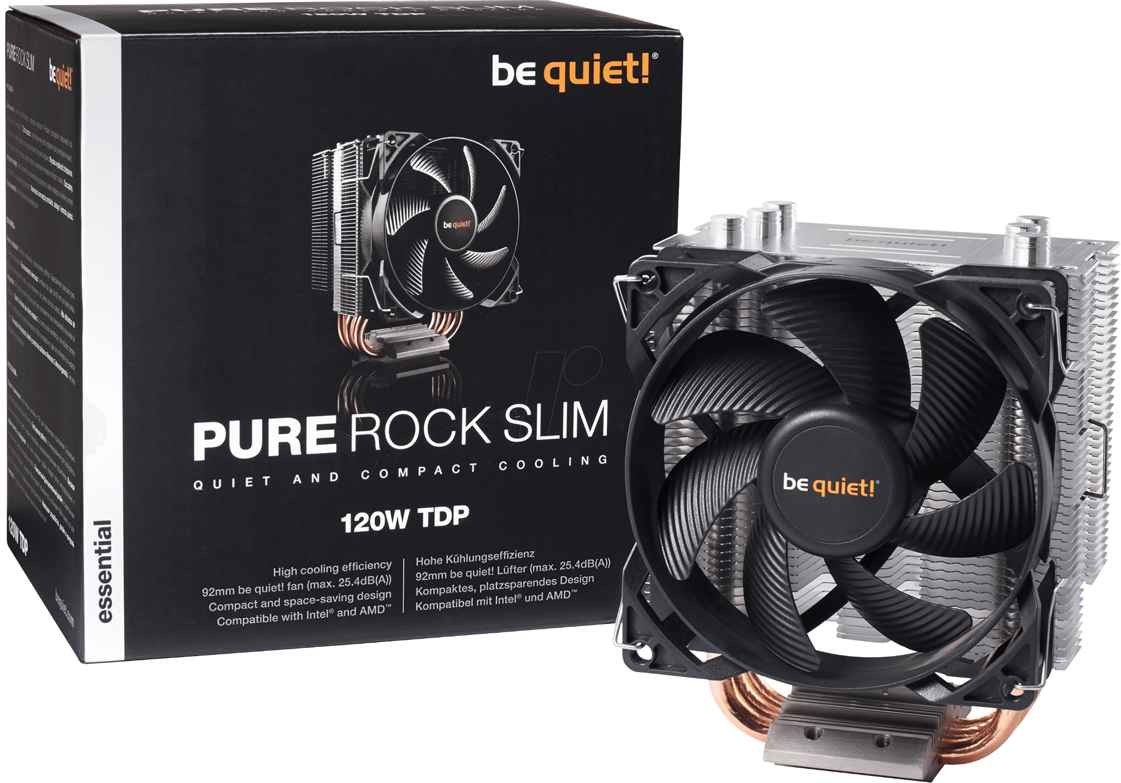
SYSTEM COOLING
be quiet! Pure Rock Slim 35.14 CFM CPU Cooler
130W TDP cooling efficiency
Mounting for an even easier installation in alignment with the airflow
Small for PC cases with limited space
2, 92mm fans for silent operation of a maximum of 25.4dB
Balanced cooling and quietness
Brushed aluminum finish
Vendor: Canada Computers
Price: 40 $ CAD

Slide 8

OPERATING SYSTEM (OS)
Windows 10
Windows 10 is the latest software developed by Microsoft. It is a good OS for our home theater PC as it is an intermediate between the user and the hardware. Users will be able to use with ease the PC to stream and play movies.

Slide 9
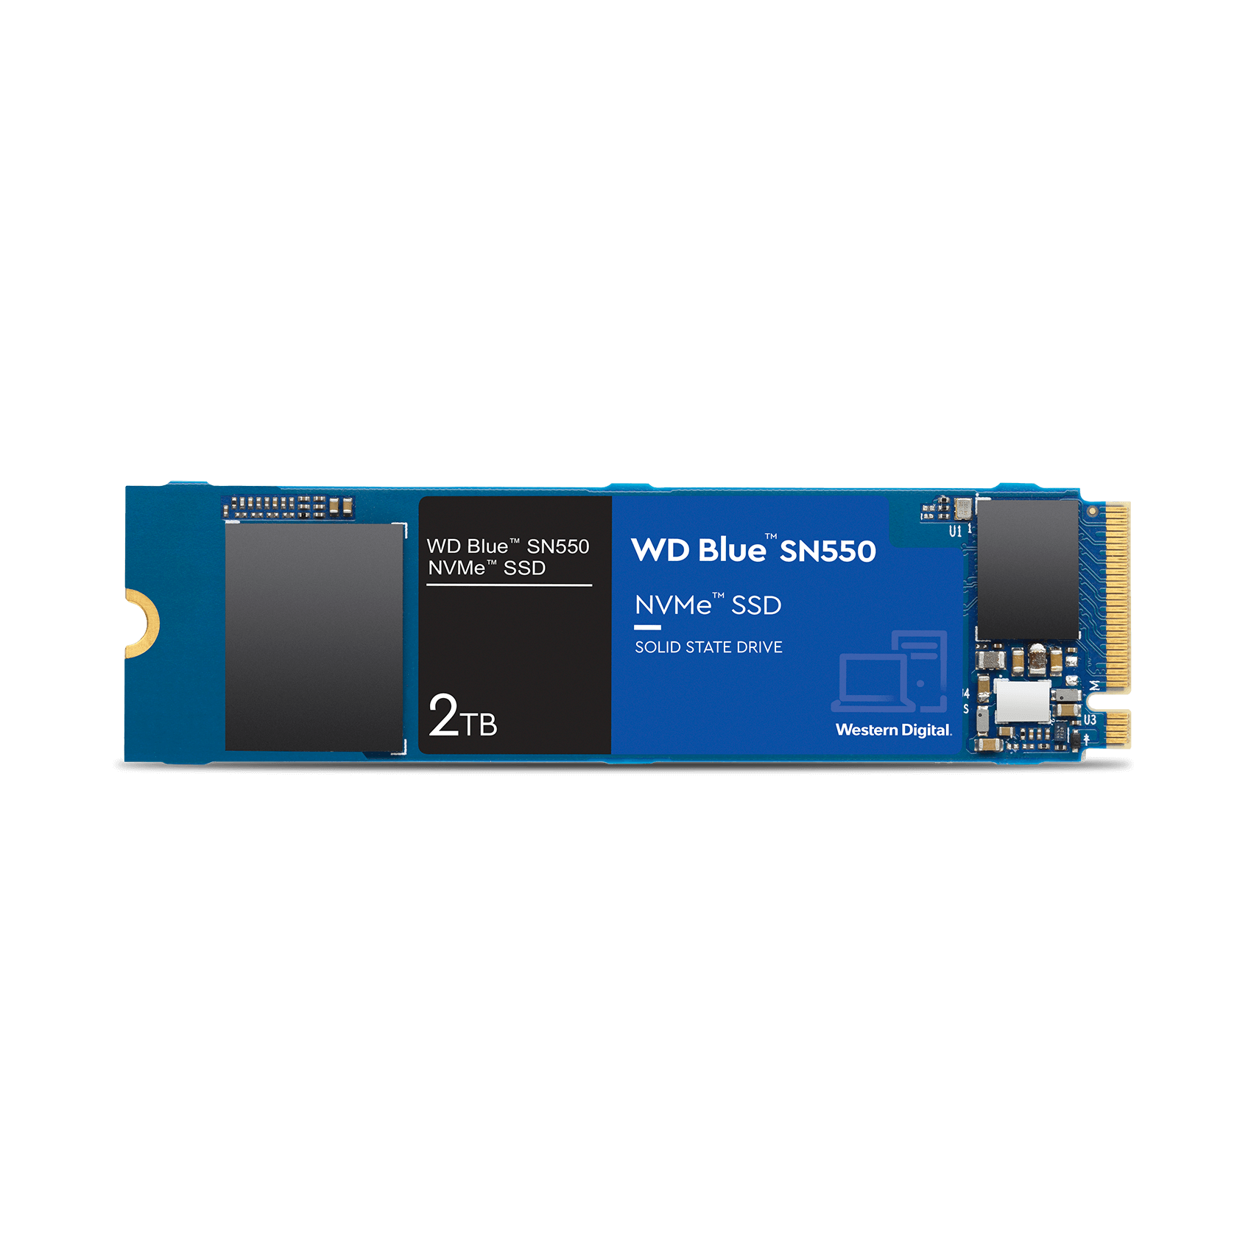
STORAGE
Western Digital Blue SN550 250GB M.2-2280 NVME Solid State Drive
Vendor: Canada Computers
Price: 60$ CAD

Slide 10
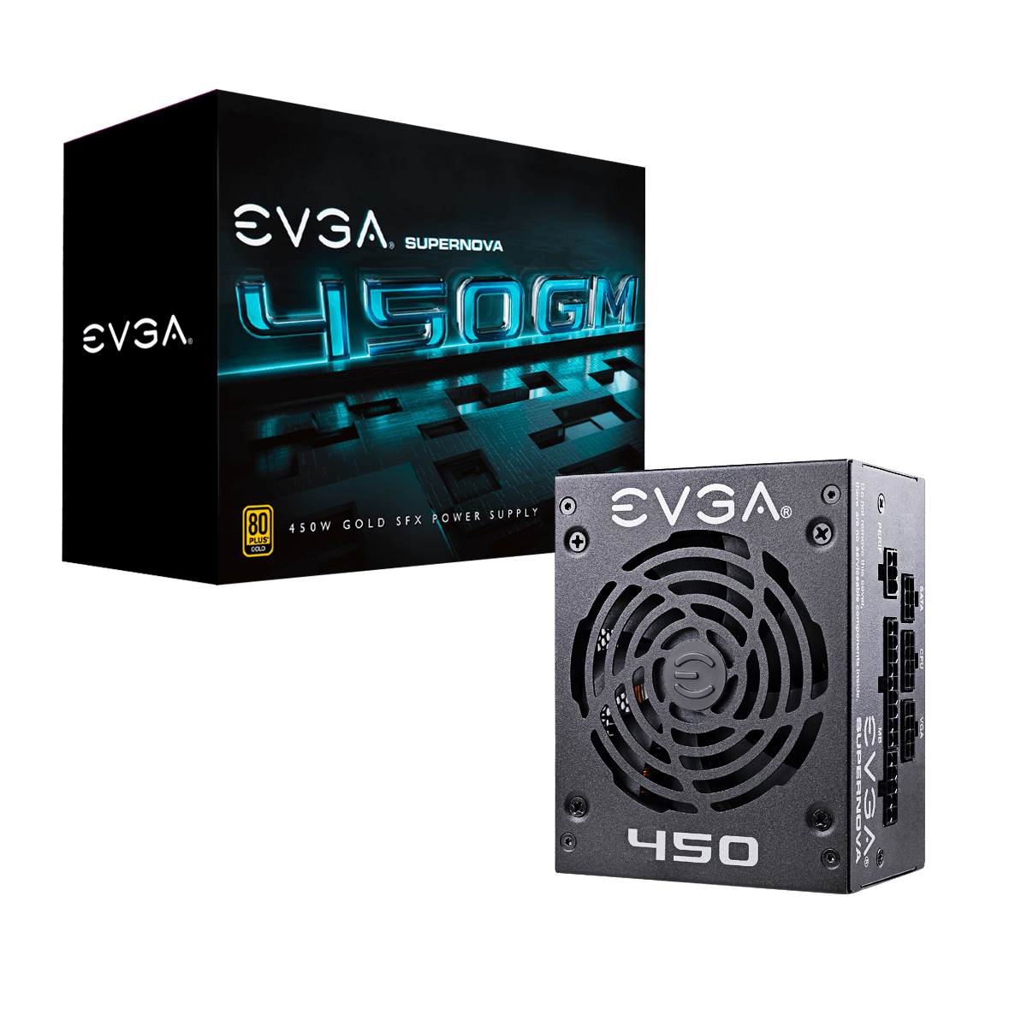
POWER SUPPLY
EVGA SuperNOVA GM 450 W 80+ Gold Certified Fully Modular SFX Power Supply
Vendor: Canada Computers
Price: 95$

Slide 11
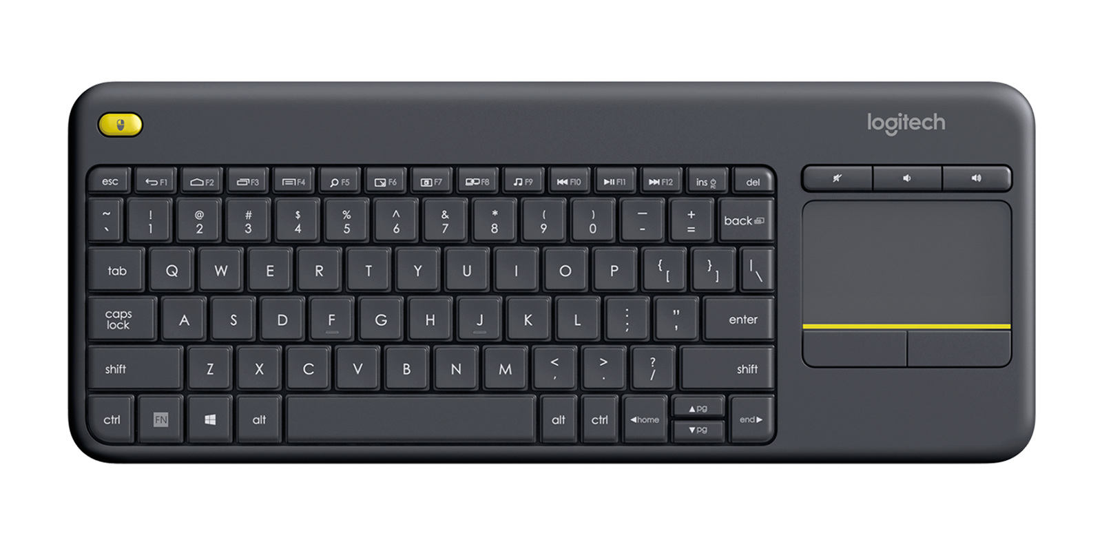
PC PERIPHERALS
Logitech K400 Plus Wireless Mini Keyboard
Vendor: Vuugo
Price: 32.56$ CAD

Slide 12
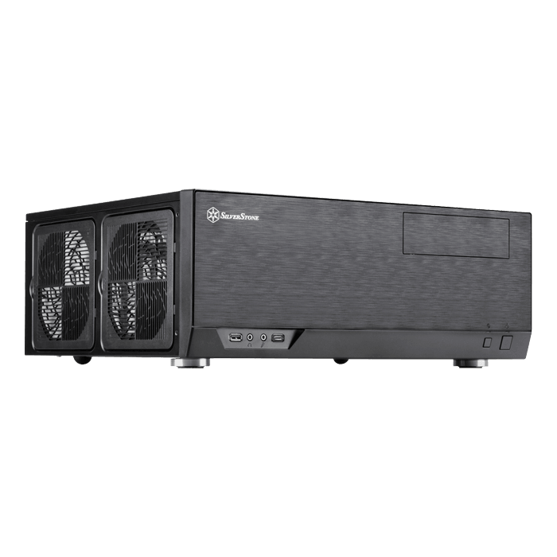
PC CASE
Silverstone GD09B HTPC Case
Vendor: Canada Computers
Price: 140$ CAD

Slide 13
THANK YOU FOR LISTENING!
<3<3<3

